Slide 1
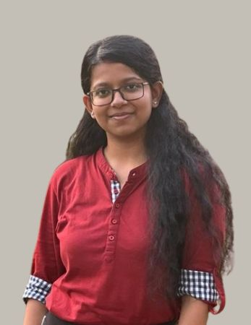
Shell Bootcamp 2024 Reflections for Week 1
Rohita Chakraborty
Date : 30-Aug-2024

Slide 2

About Me
Family is our foundation; happiness is our goal!

Slide 3

My learnings from this week!

Slide 4
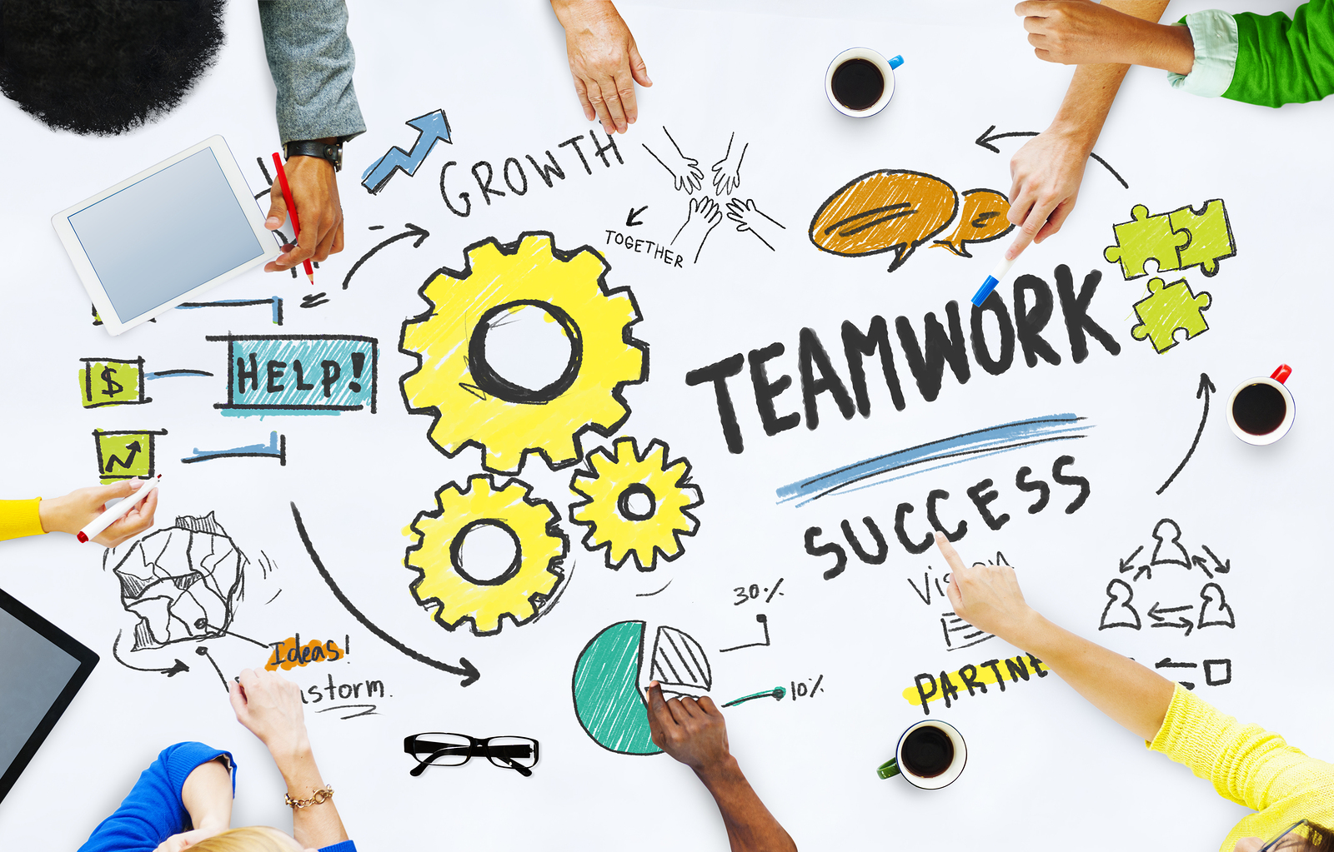
Day 1 | My takeaways
Importance of teamwork
Concept of win-win
Speak loudly and make yourself heard
Fixed mindset and growth mindset
Etiquettes to be followed in a corporate setting
Grooming Tips

Slide 5
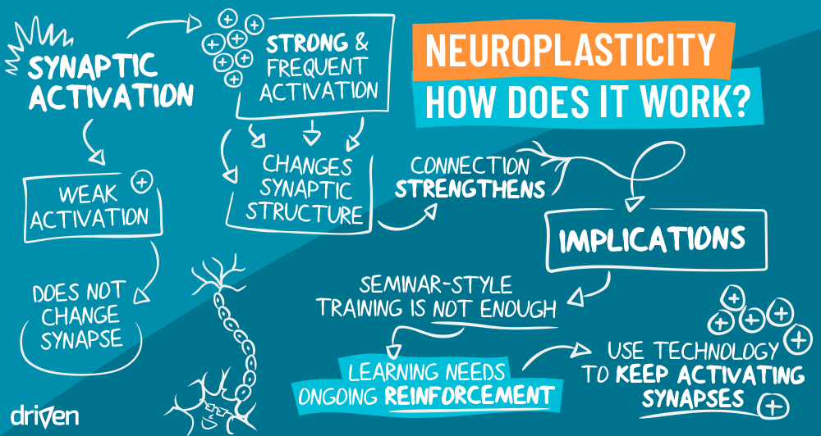
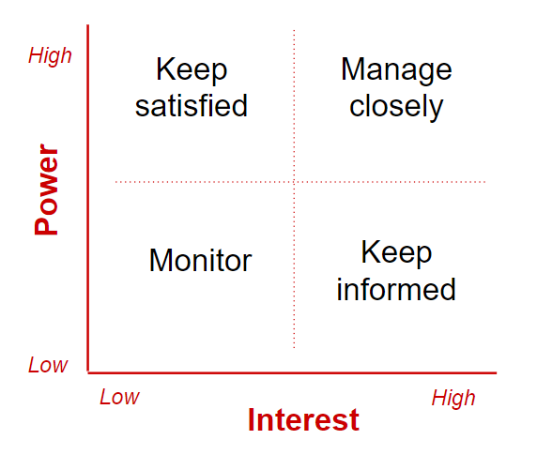
Day 2 | My takeaways
Mind exercise to remember sequences
Understanding neuroplasticity
People involved and people affected during different circumstances
Identifying stakeholders, planning stakeholder management, stakeholder engagement, control stakeholder engagement
Benefits for understanding stakeholders
Learning about the Power Interest Grid

Slide 6
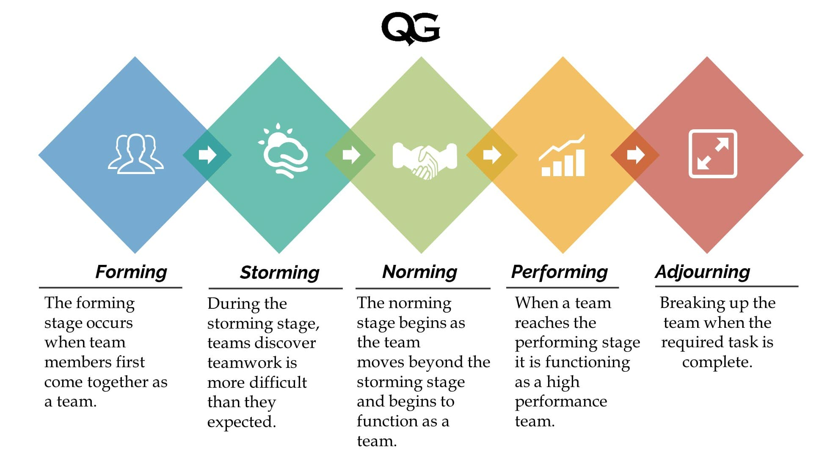
Day 3 | My takeaways
Learnt the 2 types of structure of speech – OBC (Opening, Body, Conclusion) and PREP (Point, Reason, Example, Point) and gave a 3-minute speech on a topic of our choice
Understood the importance of Power of Triad and watched the speech of winner of Toastmasters 2014
Discussed the stages of Team formation – Forming, Norming, Storming, Performing
Learnt about the Shell Trust Equation of credibility, reliability and integrity over self orientation

Slide 7
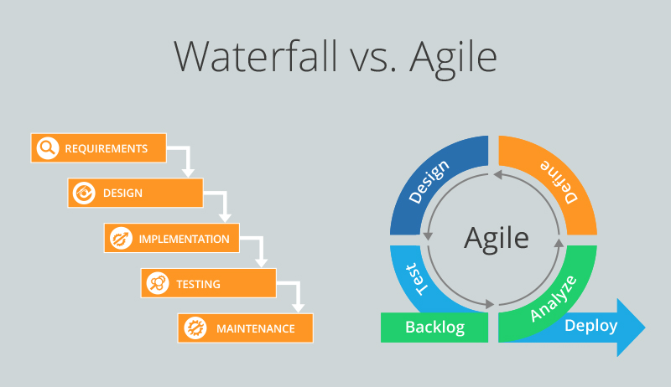
Day 4 | My takeaways
Learnt about the following topics –
Stand up meetings
SoS (Scrum of Scrums)
Business Analysis
Functional and Non-functional requirements
SDLC model (Software Development Life Cycle) and its 7 stages
Requirement analysis and techniques for requirement gathering
Waterfall model and Agile model
PI (Product Increment) model

Slide 8
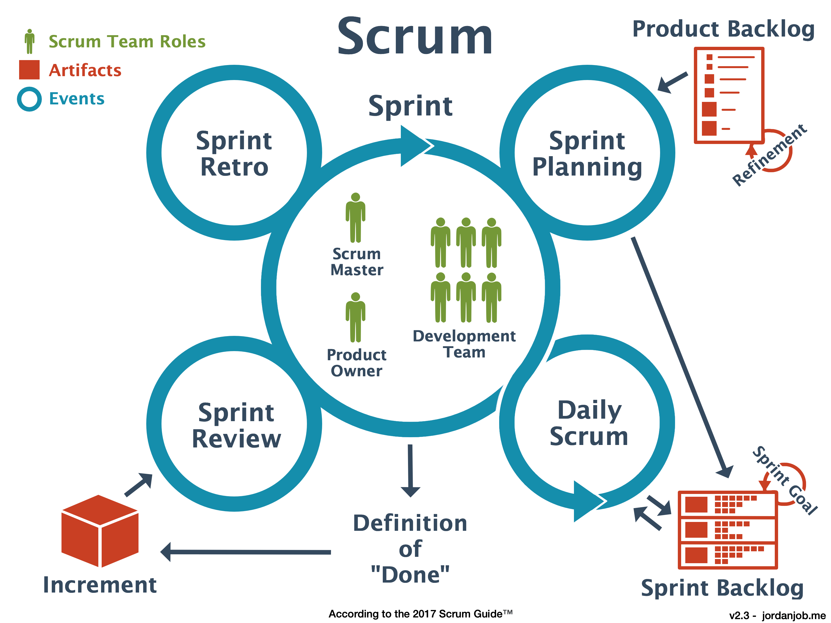
Day 5 | My takeaways
Learnt about the following topics –
Epics, User stories, Sprints
Burndown vs Burnup charts
Retrospective
Monolithic architecture vs Microservice architecture
Scrum benefits
Product backlog
User story vs enabler story
Definition of Ready (DOR) vs Definition of Done (DOD) checklist

Slide 9

Relevance of learnings for my organization

Slide 10
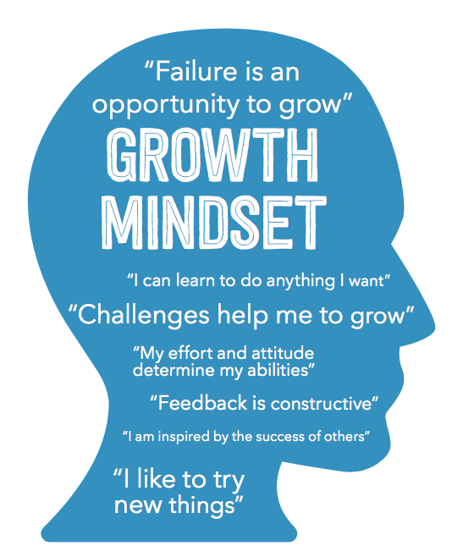
Learning 1 | Relevance for Shell
Attitude and mindset –
According to me, Shell implements the core concept of treating everyone with respect and having a learner mindset.
According to me, Shell benefits from this because having a positive attitude and a growth mindset is very important for innovation in workplace and the success of the company

Slide 11

Learning 2 | Relevance for Shell
Neuroplasticity -
According to me, Shell implements neuroplasticity by teaching the importance of connecting and networking with people.
According to me, Shell benefits from networking within the company because it helps to understand the strengths of different individuals and how their skills can be beneficial in different sectors of the company.

Slide 12
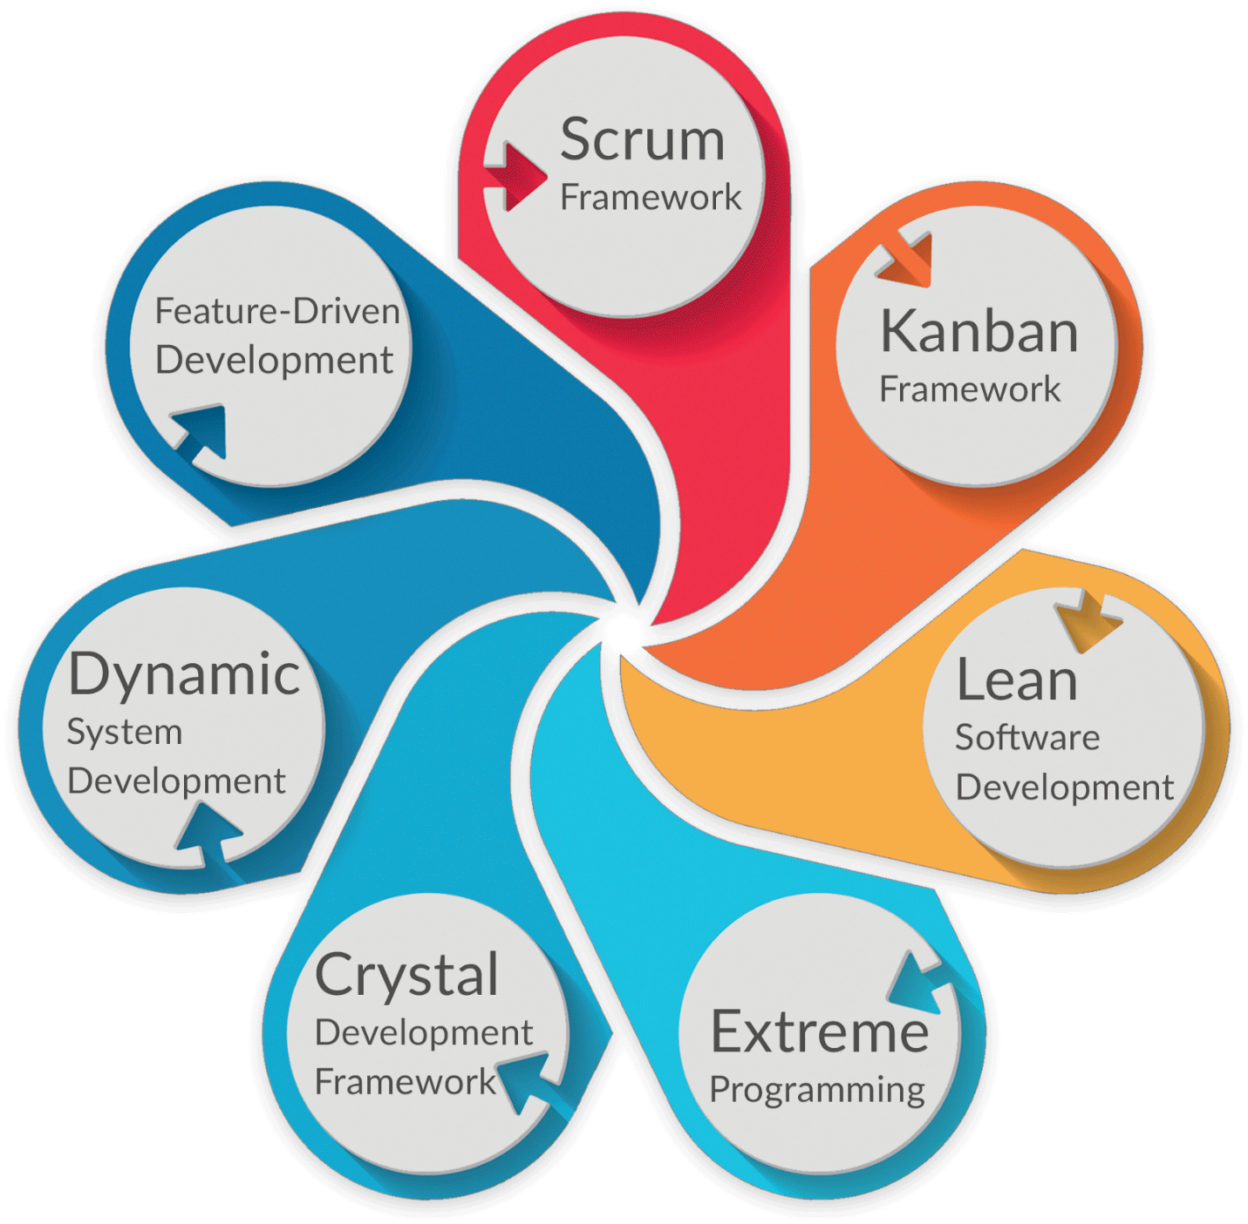
Learning 3 | Relevance for Shell
Agile methodology -
According to me, Shell implements Agile methodology in different departments across the company for their work.
According to me, Shell benefits from this methodology because it is preferred over the waterfall methodology. It has several benefits like – improved quality, adaptability and better communication.

Slide 13

Challenges in implementing learning

Slide 14
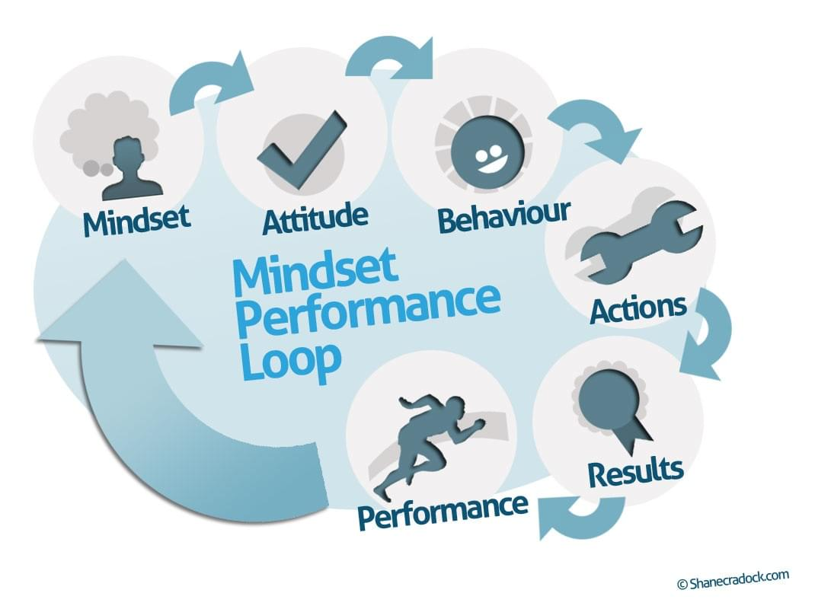
Challenge faced while implementing Learning 1
In the beginning when we were doing group presentations, many of us were hesitant and shy. However, we grew comfortable and started embracing the learning attitude and mindset. It helped us in understanding the essential soft skills needed to communicate effectively and strive for success.

Slide 15

Challenge faced while implementing Learning 2
At the beginning, most of us did not know each other at all. However, after the end of the first day, I knew the name of all 30 of my friends in my batch and grew close to a lot of them. This helped us in developing close connections and further motivated us to get to know other colleagues as well.

Slide 16
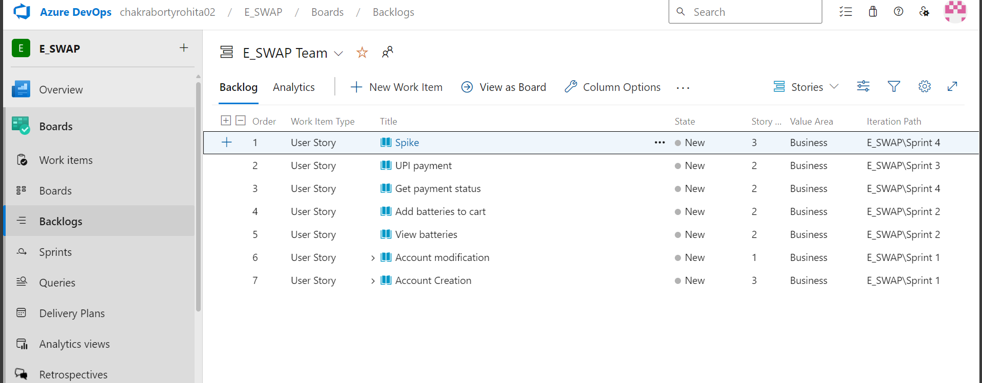
Challenge faced while implementing Learning 3
Learning about the agile methodology was a little difficult at first as it was a new topic, but it was interesting. The hands-on experience on azure dev ops helped us get a deep insight on the working of the entire agile methodology.

Slide 17

Action Plan

Slide 18
My Action Plan for this Week
Actions
Timeline
Status
Need to study all the materials provided to us about soft skills and learn about all the technologies that we will be learning in the bootcamp.
In the weekend, I will be revising soft skills and practice azure dev ops to know more about agile methodology.
I hope I finish all my work and learn new things which I can apply to my work here.

Slide 19

Learning is also Fun!

Slide 20
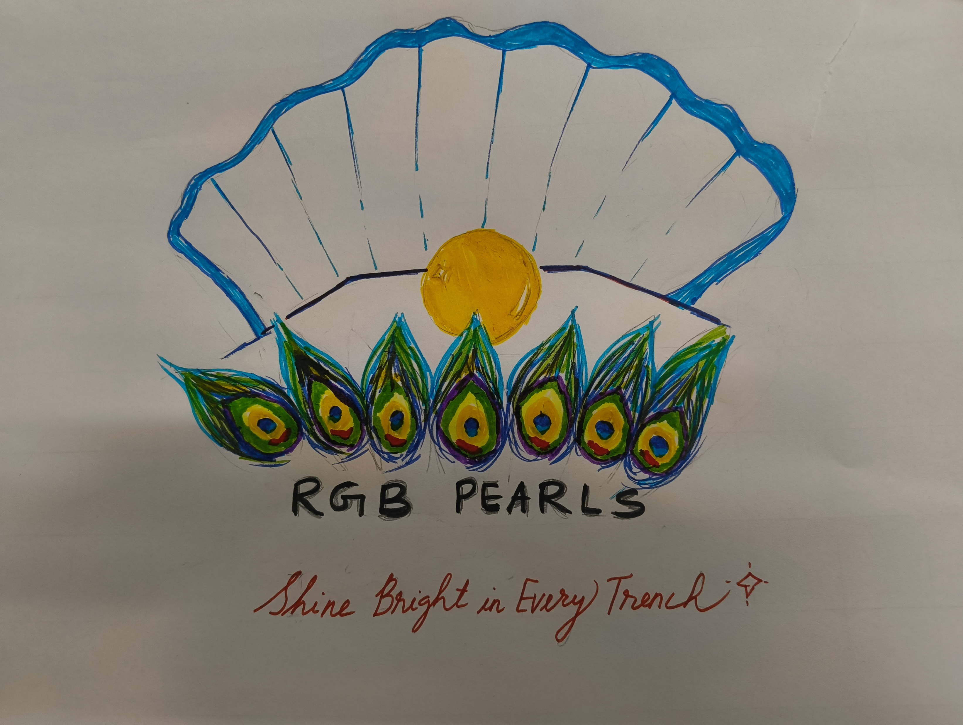
Learning is also Fun!
We performed a lot of group activities which were a lot of fun. We got to know a lot about our friends and bonded over the memories we created.

Slide 21

Summary
Growth mindset
Learning attitude
Stakeholder management
Neuroplasticity
Agile methodology
SDLC model
Requirement analysis
Github link - rohita-ch/Bootcamp (github.com)

Slide 22
Thank You

